Slide 1
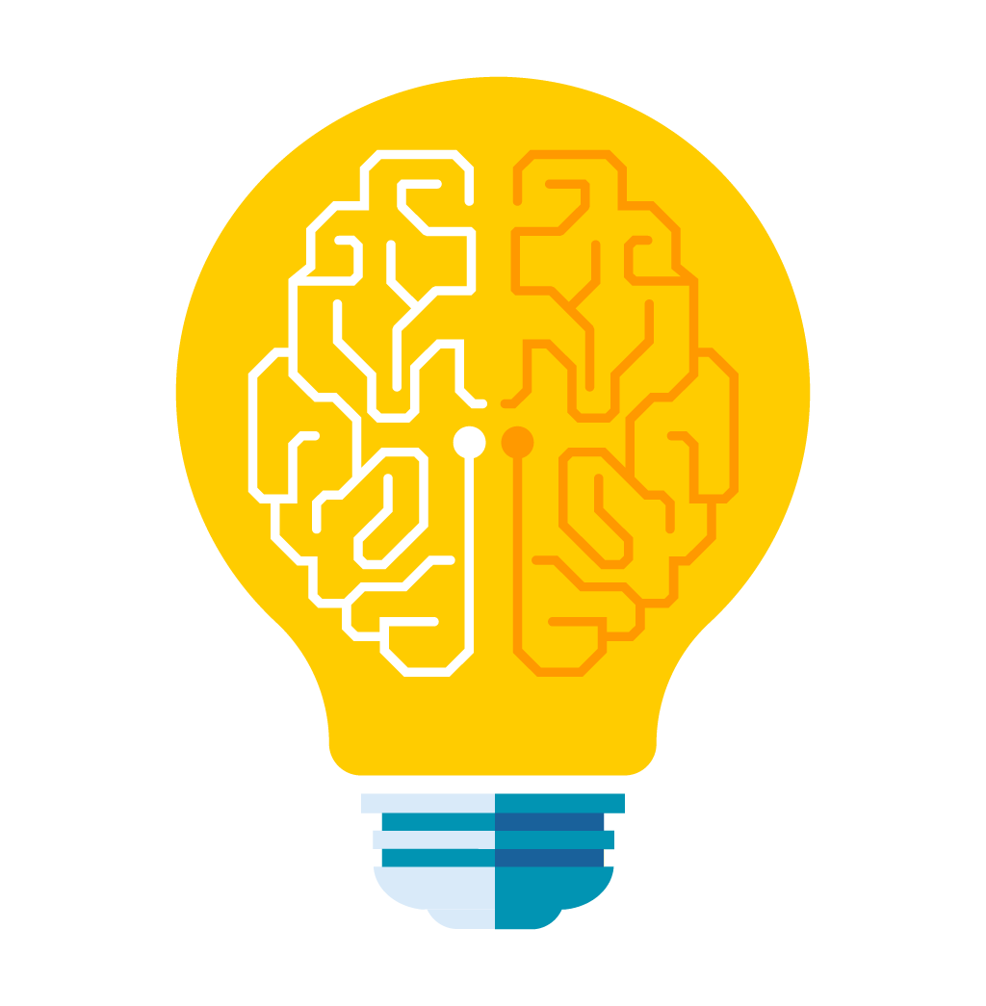
MACHINE LEARNING

Slide 2
Agenda
Introduction
What, Why, How
Challenges
Types
Regression
Linear Regression

Slide 3

Machine Learning
Machine learning is a subfield of artificial intelligence, which enables machines to learn from past data or experiences without being explicitly programmed.
Notes:
Artificial intelligence is a technology using which we can create intelligent systems that can simulate human intelligence.
Data science, this field determines the processes, systems, and tools needed to transform data into insights.(Statistics, data visualization)
Machine learning is part of data science where we train algorithms on data delivered by data science.

Slide 4

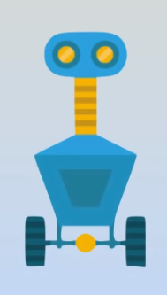

Machine Learning
Learn from Experience
Follow instructions
Learn from Experience Data

Slide 5
How Humans Learn?
Human beings learn to identify patterns when they’re exposed to a phenomenon for a prolonged period
Human beings learn from “Experience”

Slide 6
Machine Learning
A computer program/system that can learn from “Experience”
“Experience” “Data”
As more and more data is captured, Machine learning is finding a wide variety of uses

Slide 7
Problem Solving Approaches
Rule Based
Machine Learning

Slide 8
Why Machine Learning
Difficult for humans to express rules
A large amount of historical data is available
Patterns/Relationships are dynamic

Slide 9
Why Machine Learning
Solve already-solved problems in a “better” way?
Develop systems that can automatically adapt and customize themselves to individual users.
Ability to mimic human and replace certain monotonous tasks which require some intelligence
Solve problems that have not been solved before?
Discover new knowledge from large data sets.

Slide 10
Why Now?
Flood of available data.
There are 2.5 quintillion bytes of data created each day at our current pace, but that pace is only accelerating with the growth of the Internet of Things (IoT). Over the last two years alone 90 percent of the data in the world was generated.
Source – From an article on Forbes.com written on 21/05/2018
By 2025, the amount of data generated each day will reach 463 exabytes globally
Increasing computational power.
Growing progress in available algorithms and theories.
Increasing support from Industries.

Slide 11



What it Does ?
Finds patterns in data.
Builds a mathematical model from patterns found.
Use the model to predict future.

Slide 12
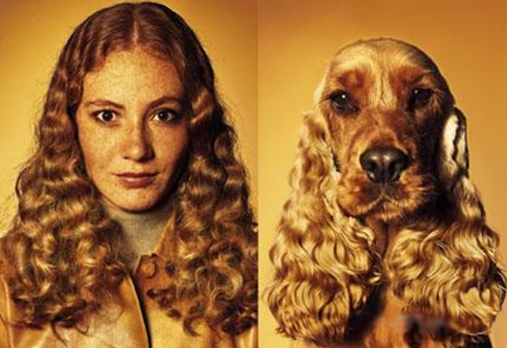
Challenges
Right Data - Choose proper parameters/data. e.g.
Right Method - Choose proper algorithms, adopt right strategies.
Right Conclusion
Notes:
Once a scientist cut a leg of a frog and played music, frog moved less, then he cut another leg and played music and frog moved lesser. When all the 4 legs were cut, frog didn't move and the scientist concluded that frogs hear with their legs.

Slide 13



Challenges
Data involved in Machine Learning is often large.
Compute power required is high in most scenarios.
Optimized to learn complex patterns

Slide 14
Applications
Spam detection
Online fraud detection
Product recommendation
Traffic prediction
Search refinement
Speech recognition
Computer vision / Object detection
Natural language processing (NLP)
Face recognition
Sentimental analysis
Financial market analysis
Medical diagnostics

Slide 15



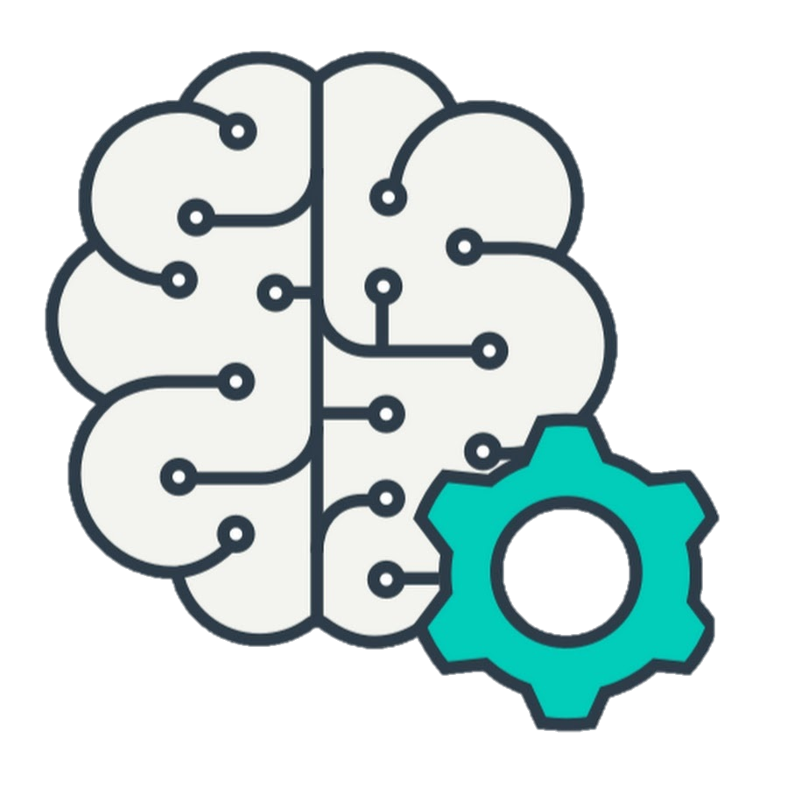

prerequisites
Right Problem/Question
Right Data
Compute Power
Effective Learning Algorithm
Stopping/Verifying Criteria
Identify the Business problem / Ask right question
Support the Question with right data
Have desired compute power & learning algorithms.
Identify the stopping criteria
Notes:
Right Question: What is the problem? Why does the problem need to be solved? How would I solve the problem? Assumptions.
Right Data: Prepare Data: Step 1: Data Selection: Consider what data is available, what data is missing and what data can be removed.
Step 2: Data Preprocessing: Organize your selected data by formatting, cleaning and sampling from it. Identify holes, duplicate data, missing values. Formatting, Cleaning, Sampling
Step 3: Data Transformation: Transform preprocessed data ready for machine learning by engineering features using scaling, attribute decomposition and attribute aggregation.
. Compute power:
Effective Learning Algorithm: Do I have an existing ML algorithm that best fits it or do I need to explore more. Algorithm Tuning and Ensemble
Stopping Criteria: When to stop. What accuracy of prediction is acceptable to me. Solutions + Findings + Limitations + Conclusions

Slide 16

MACHINE LEARNING PROCESS

Slide 17






Data Preprocessing Tools
Machine Learning Algorithms
Candidate Model
Data Providers
Raw Data
Data Pre-Processing
Structured Data
Apply Machine Learning Algorithms
Deploy Selected Model
Final Deployed Model
Applications
Notes:
Quality and Quantity of data that you gather will directly determine how good your predictive model can be. Quality is paramount and generally efficiency increases with volume of data. Data preparation, where we load our data into a suitable place and prepare it for use in our machine learning training. We’ll first put all our data together, and then randomize the ordering. If data is not randomized it can introduce a bias.
Step 1: Data Selection: Consider what data is available, what data is missing and what data can be removed.
Step 2: Data Preprocessing: Organize your selected data by formatting, cleaning and sampling from it. Identify holes, duplicate data, missing values. Most of time is spent in this process.
Step 3: Data Transformation: Transform preprocessed data ready for machine learning by engineering features using scaling, attribute decomposition and attribute aggregation.
Once done we select the training data, validation data, and test data.
The next step in our workflow is choosing a model. There are many models that researchers and data scientists have created over the years. Some are very well suited for image data, others for sequences (like text, or music), some for numerical data, others for text-based data.

Slide 18
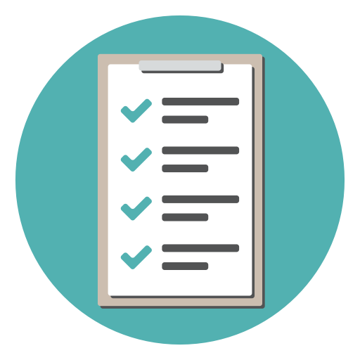
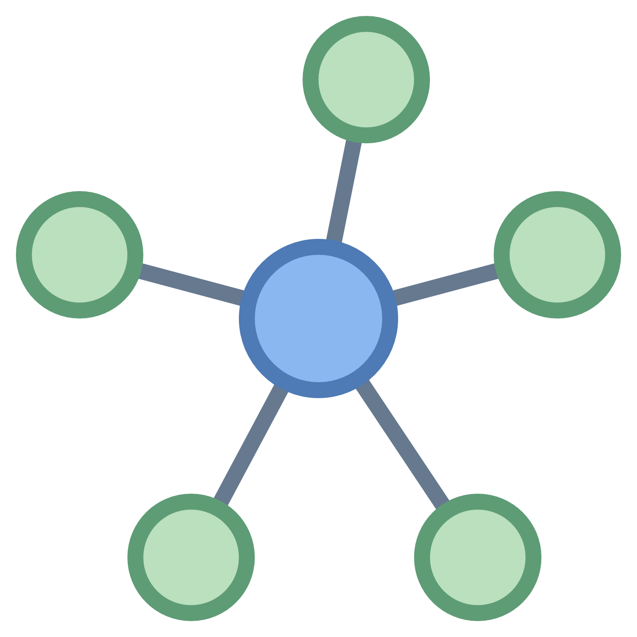
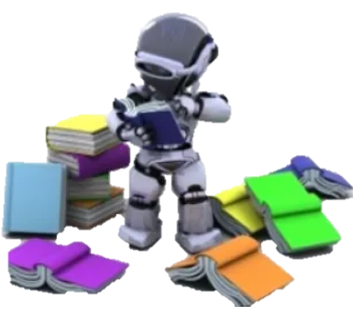



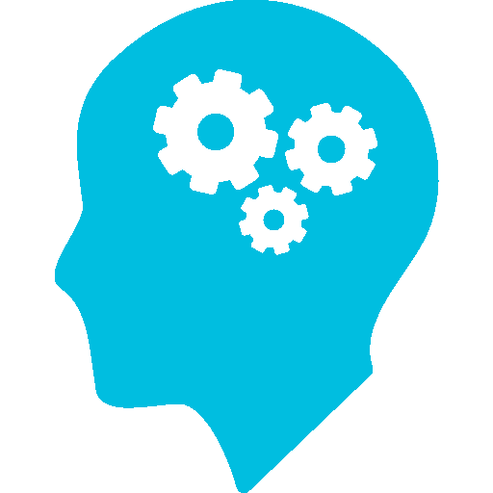
TYPES OF MACHINE LEARNING
Classification
Clustering
Unsupervised
Supervised
Dimensionality
Reduction
Regression
Reinforcement
Notes:
The majority of practical machine learning uses supervised learning. It is called supervised learning because the process of an algorithm learning from the training dataset can be thought of as a teacher supervising the learning process. We know the correct answers, the algorithm iteratively makes predictions on the training data and is corrected by the teacher. Learning stops when the algorithm achieves an acceptable level of performance.
Classification: A classification problem is when the output variable is a category, such as “red” or “blue” or “disease” and “no disease”. predicting whether a person is ill or not, detecting fraudulent transactions, face classifier.
Regression: A regression problem is when the output variable is a real value, such as “dollars” or “weight”. assessing the house price, forecasting grocery store food demand, temperature forecasting.
Unsupervised learning is where you only have input data (X) and no corresponding output variables.The goal for unsupervised learning is to model the underlying structure or distribution in the data in order to learn more about the data.These are called unsupervised learning because unlike supervised learning above there is no correct answers and there is no teacher. Algorithms are left to their own devises to discover and present the interesting structure in the data.
Clustering: A clustering problem is where you want to discover the inherent groupings in the data, such as grouping customers by purchasing behavior.
Dimensionality Reduction: Dimensions are extremely useful. But there is also something called curse of
Semi Supervised:
Problems where you have a large amount of input data (X) and only some of the data is labeled (Y) are called semi-supervised learning problems.
These problems sit in between both supervised and unsupervised learning. A good example is a photo archive where only some of the images are labeled, (e.g. dog, cat, person) and the majority are unlabeled.
Reinforcement: Has various uses

Slide 19
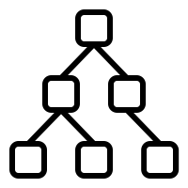
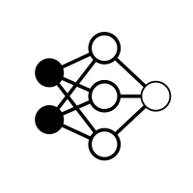
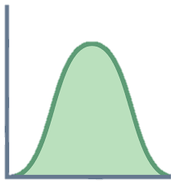
TYPES OF MACHINE LEARNING
SUPERVISED
Makes machine learn explicitly
Has labeled data
Has a known result
Supervision is needed
Decision Tree
Neural Networks
Bayesian
Notes:
The majority of practical machine learning uses supervised learning. It is called supervised learning because the process of an algorithm learning from the training dataset can be thought of as a teacher supervising the learning process. We know the correct answers, the algorithm iteratively makes predictions on the training data and is corrected by the teacher. Learning stops when the algorithm achieves an acceptable level of performance.
Classification: A classification problem is when the output variable is a category, such as “red” or “blue” or “disease” and “no disease”. predicting whether a person is ill or not, detecting fraudulent transactions, face classifier.
Regression: A regression problem is when the output variable is a real value, such as “dollars” or “weight”. assessing the house price, forecasting grocery store food demand, temperature forecasting.
Unsupervised learning is where you only have input data (X) and no corresponding output variables.The goal for unsupervised learning is to model the underlying structure or distribution in the data in order to learn more about the data.These are called unsupervised learning because unlike supervised learning above there is no correct answers and there is no teacher. Algorithms are left to their own devises to discover and present the interesting structure in the data.
Clustering: A clustering problem is where you want to discover the inherent groupings in the data, such as grouping customers by purchasing behavior.
Dimensionality Reduction: Dimensions are extremely useful. But there is also something called curse of
Semi Supervised:
Problems where you have a large amount of input data (X) and only some of the data is labeled (Y) are called semi-supervised learning problems.
These problems sit in between both supervised and unsupervised learning. A good example is a photo archive where only some of the images are labeled, (e.g. dog, cat, person) and the majority are unlabeled.
Reinforcement: Has various uses

Slide 20
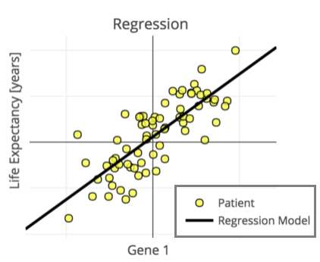
TYPES OF MACHINE LEARNING
REGRESSION
Output variable takes continuous values
Notes:
The majority of practical machine learning uses supervised learning. It is called supervised learning because the process of an algorithm learning from the training dataset can be thought of as a teacher supervising the learning process. We know the correct answers, the algorithm iteratively makes predictions on the training data and is corrected by the teacher. Learning stops when the algorithm achieves an acceptable level of performance.
Classification: A classification problem is when the output variable is a category, such as “red” or “blue” or “disease” and “no disease”. predicting whether a person is ill or not, detecting fraudulent transactions, face classifier.
Regression: A regression problem is when the output variable is a real value, such as “dollars” or “weight”. assessing the house price, forecasting grocery store food demand, temperature forecasting.
Unsupervised learning is where you only have input data (X) and no corresponding output variables.The goal for unsupervised learning is to model the underlying structure or distribution in the data in order to learn more about the data.These are called unsupervised learning because unlike supervised learning above there is no correct answers and there is no teacher. Algorithms are left to their own devises to discover and present the interesting structure in the data.
Clustering: A clustering problem is where you want to discover the inherent groupings in the data, such as grouping customers by purchasing behavior.
Dimensionality Reduction: Dimensions are extremely useful. But there is also something called curse of
Semi Supervised:
Problems where you have a large amount of input data (X) and only some of the data is labeled (Y) are called semi-supervised learning problems.
These problems sit in between both supervised and unsupervised learning. A good example is a photo archive where only some of the images are labeled, (e.g. dog, cat, person) and the majority are unlabeled.
Reinforcement: Has various uses

Slide 21
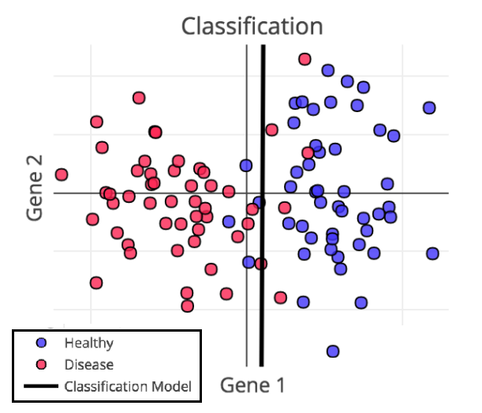
TYPES OF MACHINE LEARNING
CLASSIFICATION
Output variable takes discrete values
Notes:
The majority of practical machine learning uses supervised learning. It is called supervised learning because the process of an algorithm learning from the training dataset can be thought of as a teacher supervising the learning process. We know the correct answers, the algorithm iteratively makes predictions on the training data and is corrected by the teacher. Learning stops when the algorithm achieves an acceptable level of performance.
Classification: A classification problem is when the output variable is a category, such as “red” or “blue” or “disease” and “no disease”. predicting whether a person is ill or not, detecting fraudulent transactions, face classifier.
Regression: A regression problem is when the output variable is a real value, such as “dollars” or “weight”. assessing the house price, forecasting grocery store food demand, temperature forecasting.
Unsupervised learning is where you only have input data (X) and no corresponding output variables.The goal for unsupervised learning is to model the underlying structure or distribution in the data in order to learn more about the data.These are called unsupervised learning because unlike supervised learning above there is no correct answers and there is no teacher. Algorithms are left to their own devises to discover and present the interesting structure in the data.
Clustering: A clustering problem is where you want to discover the inherent groupings in the data, such as grouping customers by purchasing behavior.
Dimensionality Reduction: Dimensions are extremely useful. But there is also something called curse of
Semi Supervised:
Problems where you have a large amount of input data (X) and only some of the data is labeled (Y) are called semi-supervised learning problems.
These problems sit in between both supervised and unsupervised learning. A good example is a photo archive where only some of the images are labeled, (e.g. dog, cat, person) and the majority are unlabeled.
Reinforcement: Has various uses

Slide 22
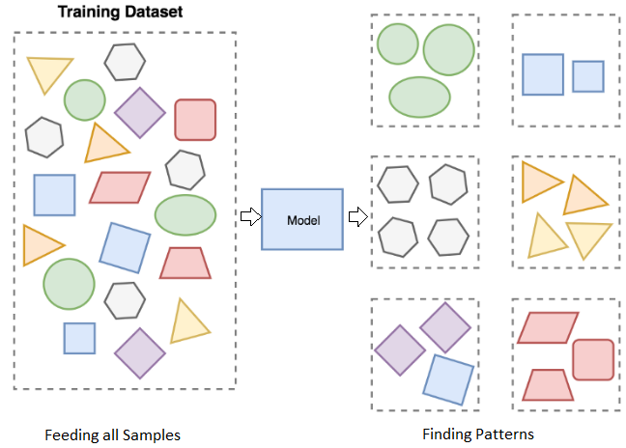
TYPES OF MACHINE LEARNING
UNSUPERVISED
Machine Understands Data
Unlabeled Data
There are no correct answers.
Discovers unknown data patterns and data structure
Notes:
The majority of practical machine learning uses supervised learning. It is called supervised learning because the process of an algorithm learning from the training dataset can be thought of as a teacher supervising the learning process. We know the correct answers, the algorithm iteratively makes predictions on the training data and is corrected by the teacher. Learning stops when the algorithm achieves an acceptable level of performance.
Classification: A classification problem is when the output variable is a category, such as “red” or “blue” or “disease” and “no disease”. predicting whether a person is ill or not, detecting fraudulent transactions, face classifier.
Regression: A regression problem is when the output variable is a real value, such as “dollars” or “weight”. assessing the house price, forecasting grocery store food demand, temperature forecasting.
Unsupervised learning is where you only have input data (X) and no corresponding output variables.The goal for unsupervised learning is to model the underlying structure or distribution in the data in order to learn more about the data.These are called unsupervised learning because unlike supervised learning above there is no correct answers and there is no teacher. Algorithms are left to their own devises to discover and present the interesting structure in the data.
Clustering: A clustering problem is where you want to discover the inherent groupings in the data, such as grouping customers by purchasing behavior.
Dimensionality Reduction: Dimensions are extremely useful. But there is also something called curse of
Semi Supervised:
Problems where you have a large amount of input data (X) and only some of the data is labeled (Y) are called semi-supervised learning problems.
These problems sit in between both supervised and unsupervised learning. A good example is a photo archive where only some of the images are labeled, (e.g. dog, cat, person) and the majority are unlabeled.
Reinforcement: Has various uses

Slide 23
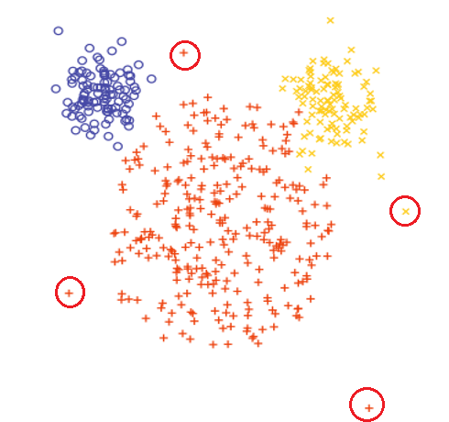
TYPES OF MACHINE LEARNING
CLUSTERING
Process of dividing and grouping similar data samples together.
Groups are usually called clusters.
Effective in outlier detection
Notes:
The majority of practical machine learning uses supervised learning. It is called supervised learning because the process of an algorithm learning from the training dataset can be thought of as a teacher supervising the learning process. We know the correct answers, the algorithm iteratively makes predictions on the training data and is corrected by the teacher. Learning stops when the algorithm achieves an acceptable level of performance.
Classification: A classification problem is when the output variable is a category, such as “red” or “blue” or “disease” and “no disease”. predicting whether a person is ill or not, detecting fraudulent transactions, face classifier.
Regression: A regression problem is when the output variable is a real value, such as “dollars” or “weight”. assessing the house price, forecasting grocery store food demand, temperature forecasting.
Unsupervised learning is where you only have input data (X) and no corresponding output variables.The goal for unsupervised learning is to model the underlying structure or distribution in the data in order to learn more about the data.These are called unsupervised learning because unlike supervised learning above there is no correct answers and there is no teacher. Algorithms are left to their own devises to discover and present the interesting structure in the data.
Clustering: A clustering problem is where you want to discover the inherent groupings in the data, such as grouping customers by purchasing behavior.
Dimensionality Reduction: Dimensions are extremely useful. But there is also something called curse of
Semi Supervised:
Problems where you have a large amount of input data (X) and only some of the data is labeled (Y) are called semi-supervised learning problems.
These problems sit in between both supervised and unsupervised learning. A good example is a photo archive where only some of the images are labeled, (e.g. dog, cat, person) and the majority are unlabeled.
Reinforcement: Has various uses

Slide 24
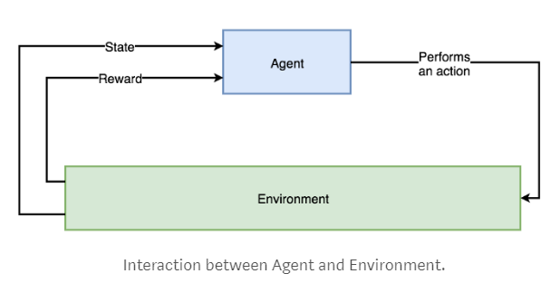
TYPES OF MACHINE LEARNING
REINFORCEMENT
Receives information from the environment and react to it by performing an action.
Reward based
Reward can be either +ve or –ve.
Notes:
The majority of practical machine learning uses supervised learning. It is called supervised learning because the process of an algorithm learning from the training dataset can be thought of as a teacher supervising the learning process. We know the correct answers, the algorithm iteratively makes predictions on the training data and is corrected by the teacher. Learning stops when the algorithm achieves an acceptable level of performance.
Classification: A classification problem is when the output variable is a category, such as “red” or “blue” or “disease” and “no disease”. predicting whether a person is ill or not, detecting fraudulent transactions, face classifier.
Regression: A regression problem is when the output variable is a real value, such as “dollars” or “weight”. assessing the house price, forecasting grocery store food demand, temperature forecasting.
Unsupervised learning is where you only have input data (X) and no corresponding output variables.The goal for unsupervised learning is to model the underlying structure or distribution in the data in order to learn more about the data.These are called unsupervised learning because unlike supervised learning above there is no correct answers and there is no teacher. Algorithms are left to their own devises to discover and present the interesting structure in the data.
Clustering: A clustering problem is where you want to discover the inherent groupings in the data, such as grouping customers by purchasing behavior.
Dimensionality Reduction: Dimensions are extremely useful. But there is also something called curse of
Semi Supervised:
Problems where you have a large amount of input data (X) and only some of the data is labeled (Y) are called semi-supervised learning problems.
These problems sit in between both supervised and unsupervised learning. A good example is a photo archive where only some of the images are labeled, (e.g. dog, cat, person) and the majority are unlabeled.
Reinforcement: Has various uses

Slide 25


WHEN TO GO FOR MACHINE LEARNING
When you cannot code the rules.
Data is ever changing / increasing.
When you have sufficient and relevant data.
Sufficient time and infrastructure.
Information gathered has value
Problem is simple and can be solved using traditional programming.
Not sufficient or good data.
Too noisy data.
Insufficient infrastructure.
Notes:
The majority of practical machine learning uses supervised learning. It is called supervised learning because the process of an algorithm learning from the training dataset can be thought of as a teacher supervising the learning process. We know the correct answers, the algorithm iteratively makes predictions on the training data and is corrected by the teacher. Learning stops when the algorithm achieves an acceptable level of performance.
Classification: A classification problem is when the output variable is a category, such as “red” or “blue” or “disease” and “no disease”. predicting whether a person is ill or not, detecting fraudulent transactions, face classifier.
Regression: A regression problem is when the output variable is a real value, such as “dollars” or “weight”. assessing the house price, forecasting grocery store food demand, temperature forecasting.
Unsupervised learning is where you only have input data (X) and no corresponding output variables.The goal for unsupervised learning is to model the underlying structure or distribution in the data in order to learn more about the data.These are called unsupervised learning because unlike supervised learning above there is no correct answers and there is no teacher. Algorithms are left to their own devises to discover and present the interesting structure in the data.
Clustering: A clustering problem is where you want to discover the inherent groupings in the data, such as grouping customers by purchasing behavior.
Dimensionality Reduction: Dimensions are extremely useful. But there is also something called curse of
Semi Supervised:
Problems where you have a large amount of input data (X) and only some of the data is labeled (Y) are called semi-supervised learning problems.
These problems sit in between both supervised and unsupervised learning. A good example is a photo archive where only some of the images are labeled, (e.g. dog, cat, person) and the majority are unlabeled.
Reinforcement: Has various uses

Slide 26





Commonly USED TOOLS AND LIBRARIES
Scikit-learn
TensorFlow
Theano
Caffe
Matplotlib
Plotly
Caret
MLR
h2o
MLlib(Spark) - Java
Mahout - Java
Shark – C++
LibSVM - C++
Notes:
The majority of practical machine learning uses supervised learning. It is called supervised learning because the process of an algorithm learning from the training dataset can be thought of as a teacher supervising the learning process. We know the correct answers, the algorithm iteratively makes predictions on the training data and is corrected by the teacher. Learning stops when the algorithm achieves an acceptable level of performance.
Classification: A classification problem is when the output variable is a category, such as “red” or “blue” or “disease” and “no disease”. predicting whether a person is ill or not, detecting fraudulent transactions, face classifier.
Regression: A regression problem is when the output variable is a real value, such as “dollars” or “weight”. assessing the house price, forecasting grocery store food demand, temperature forecasting.
Unsupervised learning is where you only have input data (X) and no corresponding output variables.The goal for unsupervised learning is to model the underlying structure or distribution in the data in order to learn more about the data.These are called unsupervised learning because unlike supervised learning above there is no correct answers and there is no teacher. Algorithms are left to their own devises to discover and present the interesting structure in the data.
Clustering: A clustering problem is where you want to discover the inherent groupings in the data, such as grouping customers by purchasing behavior.
Dimensionality Reduction: Dimensions are extremely useful. But there is also something called curse of
Semi Supervised:
Problems where you have a large amount of input data (X) and only some of the data is labeled (Y) are called semi-supervised learning problems.
These problems sit in between both supervised and unsupervised learning. A good example is a photo archive where only some of the images are labeled, (e.g. dog, cat, person) and the majority are unlabeled.
Reinforcement: Has various uses

Slide 27
Questions?

Slide 28
Thank you!

